Slide 2
A Befriend Moment
Thank you to the YMCA’s Lisa Ramirez and Abby Rogers who believed in Befriend from the early days … March 2020
And to Reggie Gordon for his support from Day 1 … December 2017
Notes:
.

Slide 3
Befriend’s Mission Statement
Befriend inspires a lifestyle of
curiosity, connection, and compassion for all.

Slide 4

Befriend’s Mission Statement
Befriend inspires a lifestyle of
curiosity, connection, and compassion for all.
We offer experiences for people to connect with others different from themselves, foster understanding and create friendships that empower people and communities to thrive.
Everyone is welcome. Everyone belongs.

Slide 5
Organic Beginning to Befriend:
An Unexpected Friendship with Ciji Redd
December 2017
Notes:
Mollie: Tell story of Ciji, Jojo and Ed briefly

Slide 6
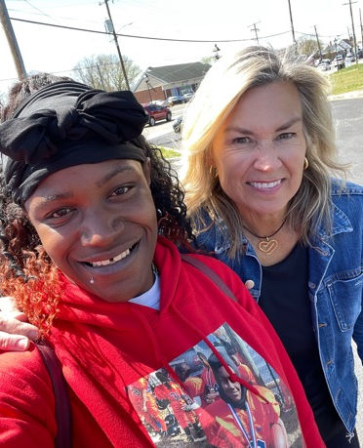
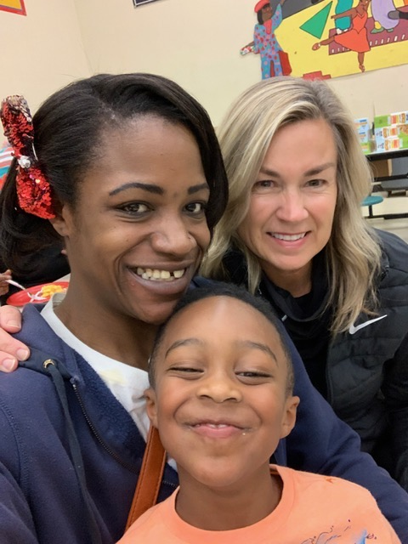
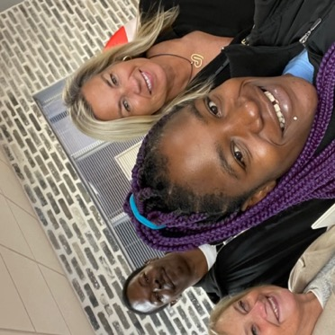
Ciji
December 2017

Slide 7
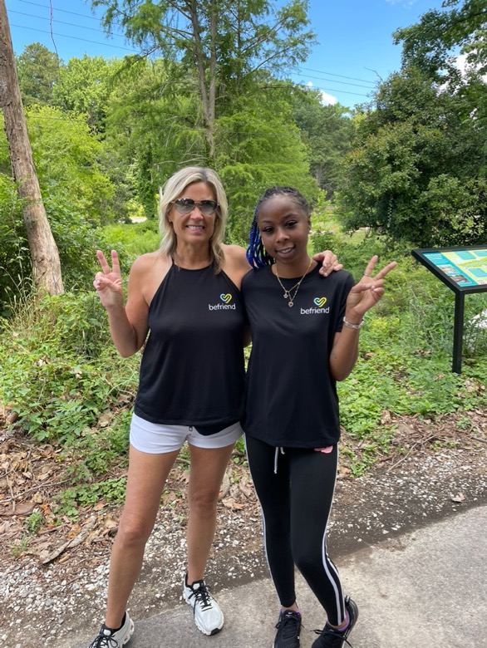
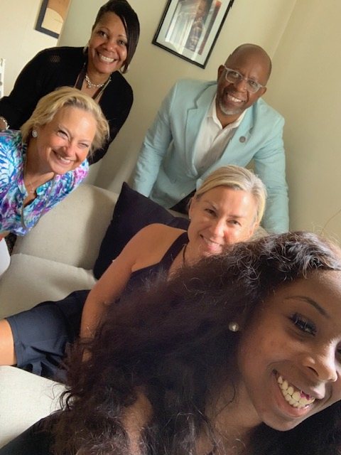
Jojo
Summer 2018

Slide 8
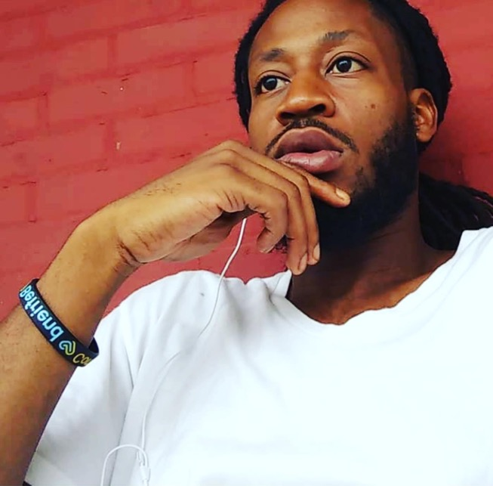
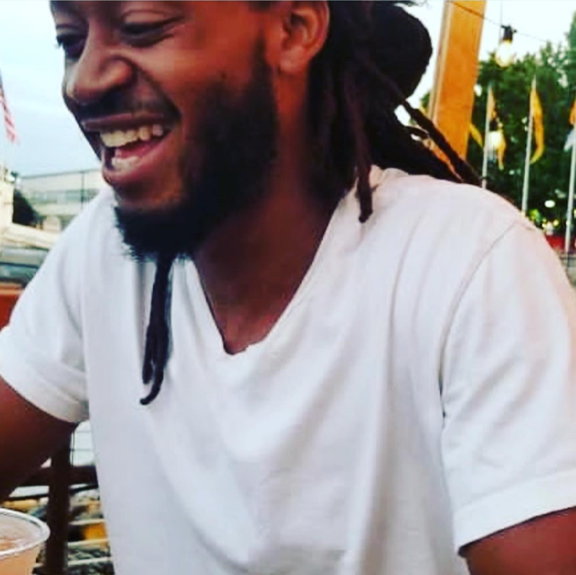
Ed
January 2019

Slide 9
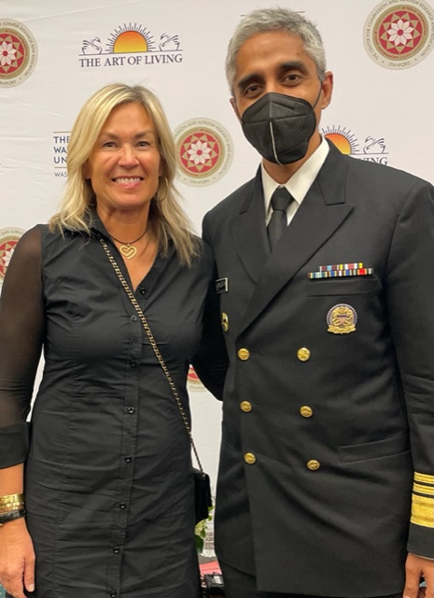
Former U.S. Surgeon General, Dr. Vivek Murthy
The Epidemic of Loneliness
Loneliness impacts people mentally and physically leading to an increase
in mental health issues & premature death.
Befriend is an Answer.
Photo: May 2022 in Washington, D. C.

Slide 10
Can something as simple as Befriend be just what we all need?

Slide 11
Core Principles of Befriend - A Sense of Belonging
Be curious & open-hearted.
Show up, get closer & meet people where they are.
It’s ok to be uncomfortable; embrace the uncertainty.
Learn, grow & change for the better.
Celebrate our common humanity.
Realize at our core we are all more alike than different while honoring the beauty of our uniquenesses

Slide 12
How do I get closer to someone different from myself?

Slide 13

Befriend’s Continuum of Compassionate Change

Slide 14
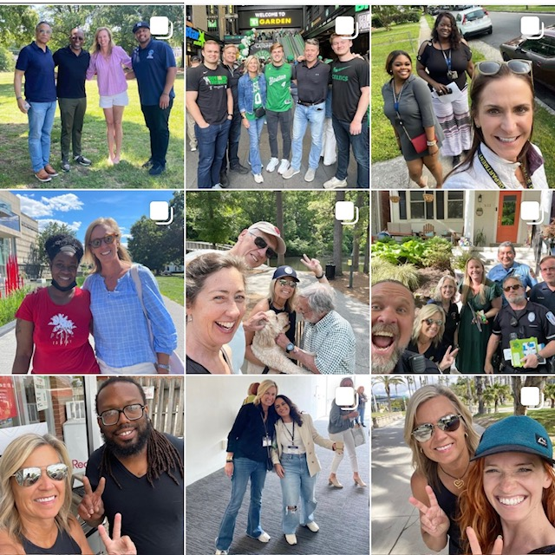
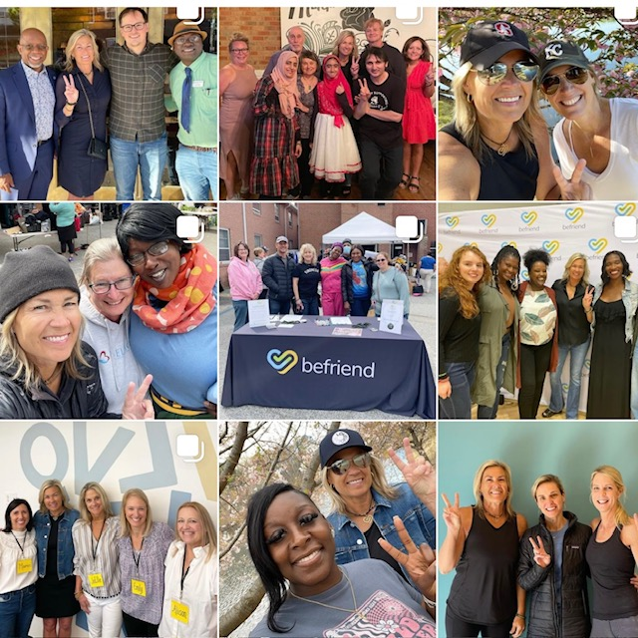
Follow Befriend on Instagram @befriend.movement.

Slide 15
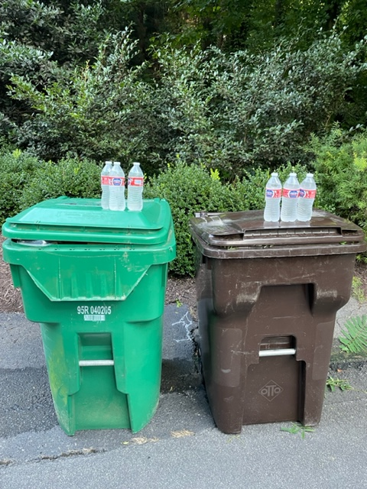
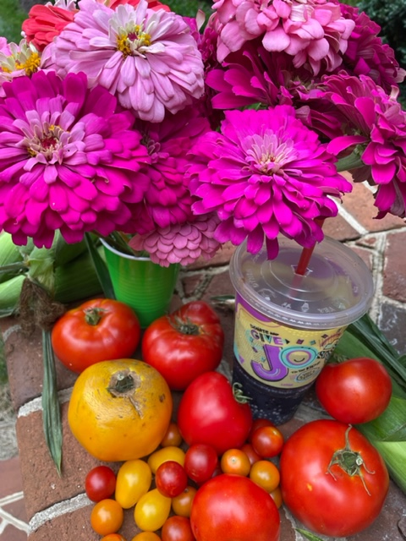
Acts of Kindness

Slide 16
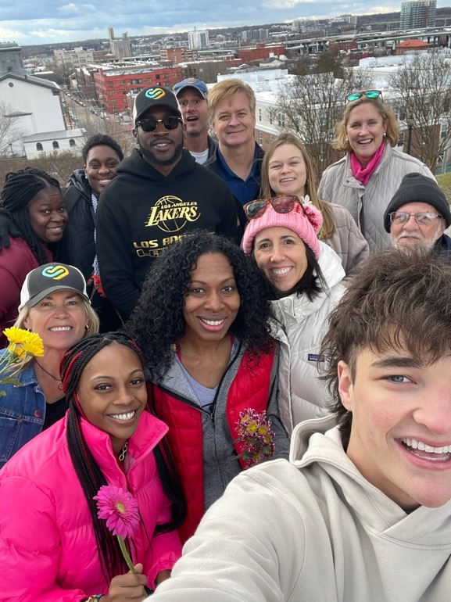
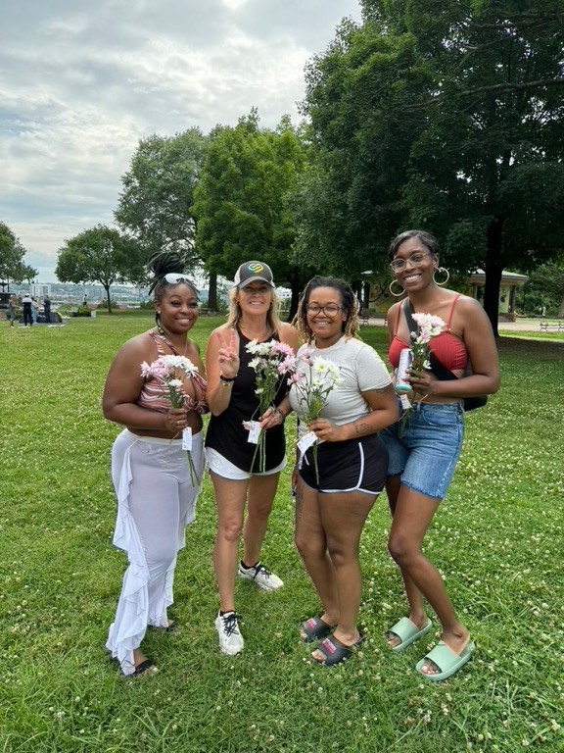
Befriend Kindness Pop-ups

Slide 17
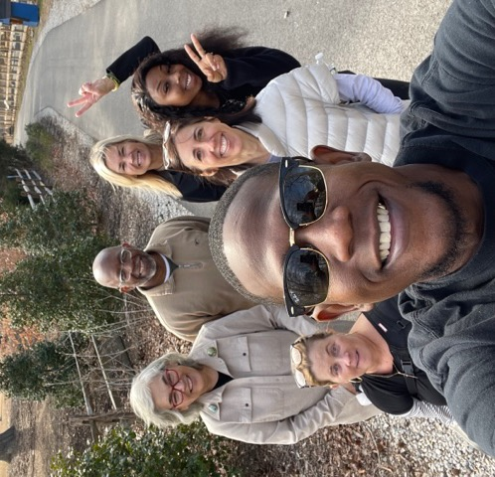
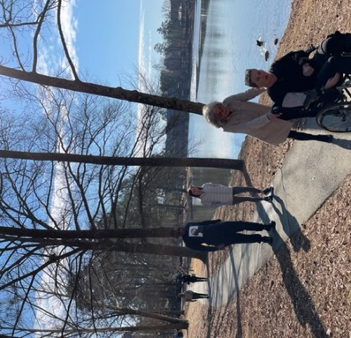
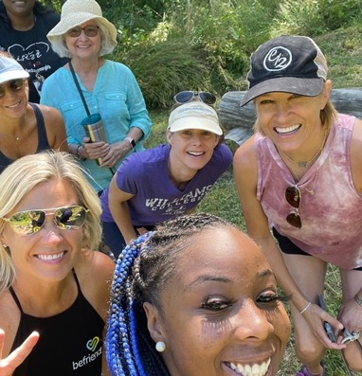
Befriend
Walks: Sharing our Stories

Slide 18
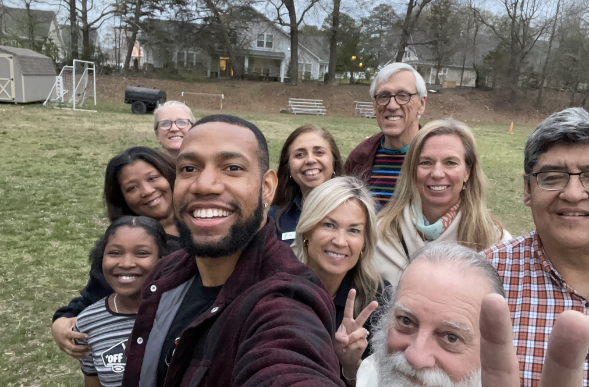
Gat
Befriend Gather - YMCA Welcome Center April 2022

Slide 19
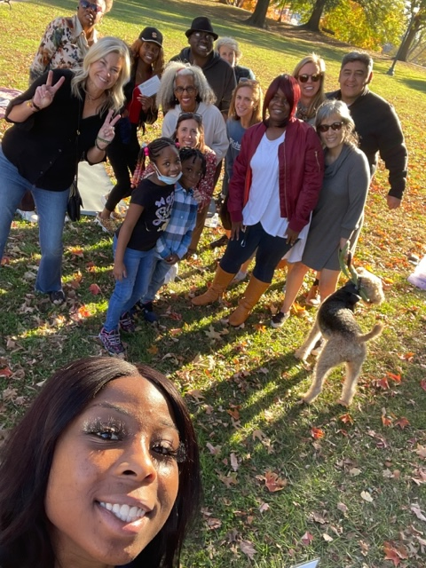
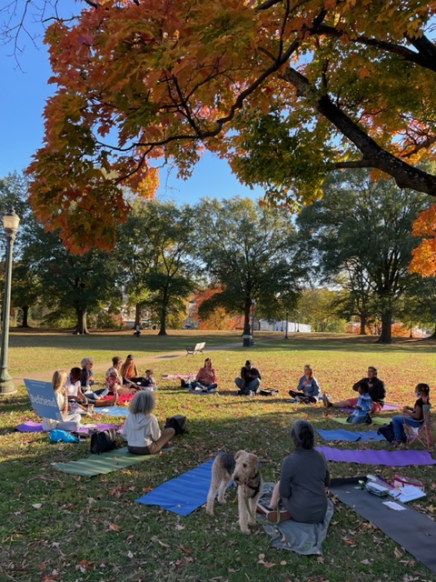
Befriend Gathers, Clean-ups & other Special Events

Slide 20
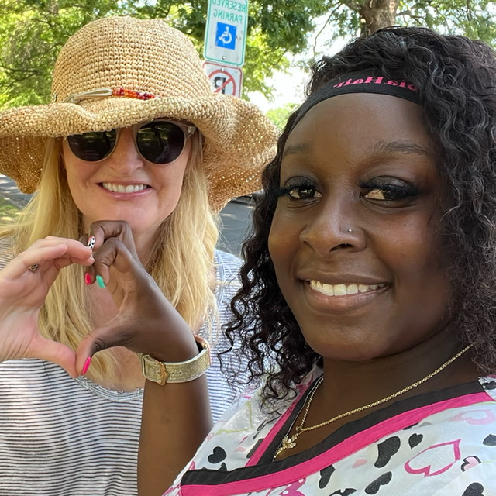
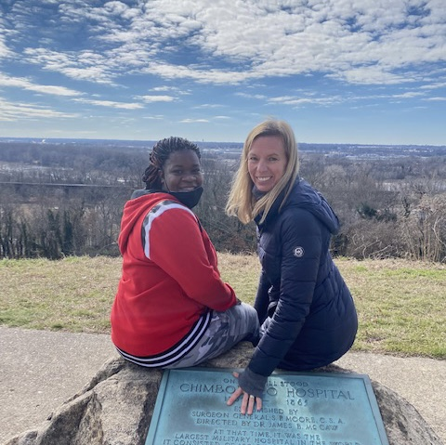
Friendships are created organically.

Slide 21
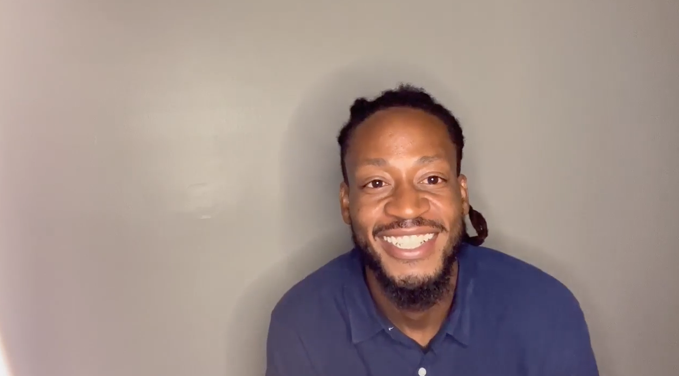
Ed in his own words…
How we met • Befriend is a lifestyle

Slide 22
The Ripple Effects of Befriend in Richmond, VA, the USA & the World!

Slide 23
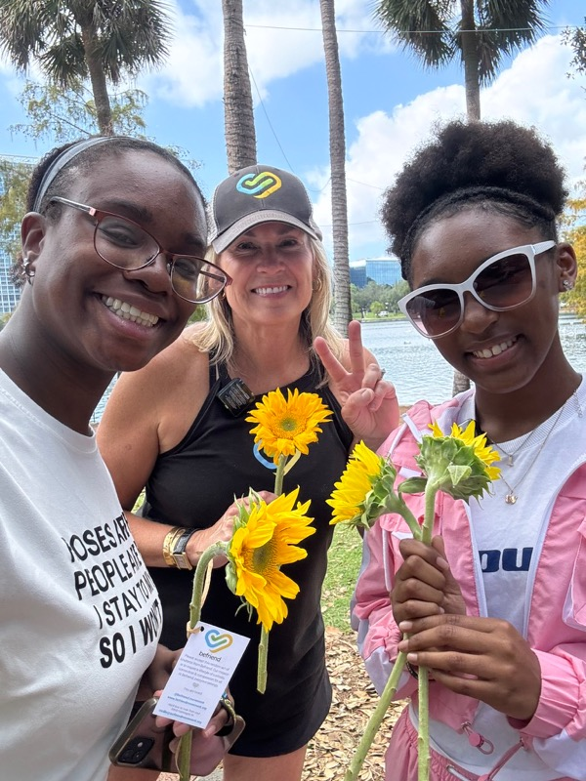
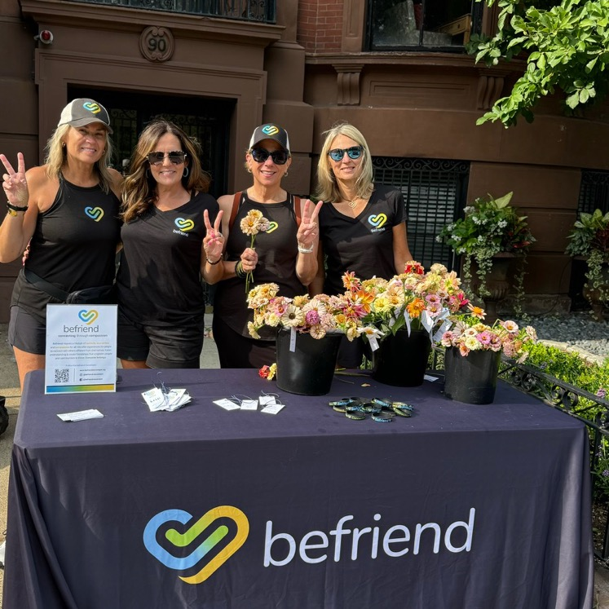
The Ripple Effects are all over the United States.

Slide 24
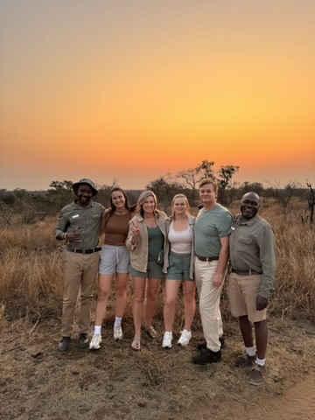
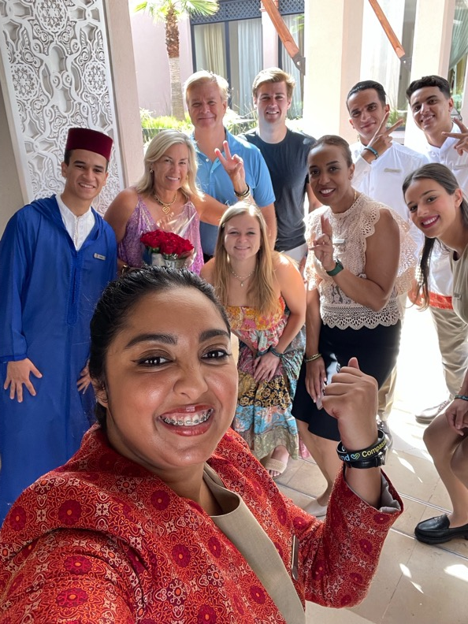
Befriend in South Africa, Morocco & more

Slide 25
Creating Change
The human connections of Befriend are examples of SOCIAL CAPITAL helping people and communities to thrive.
Both sides of the friendship are transformed and our city collectively strengthens including GENERATIONAL benefits & a feeling of being part of something BIGGER THAN YOURSELF.

Slide 26
Science-based Research
Social Capital: Dr. Raj Chetty, Harvard
Moral Elevation: Dr. Jonathan Haidt, NYU
Compassion: Dr. James Doty, Stanford
Nature: Dr. Gretchen Daily, Stanford

Slide 27
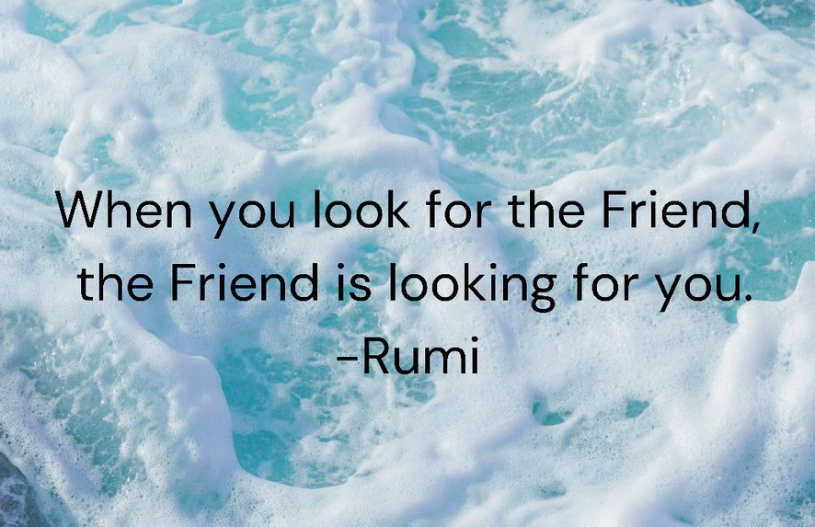

Slide 28
Rising Together
Learn about Richmond’s Past, Present & Future
Hear many people’s stories
Learn about the RVA Rising Regional Initiative & more
Let’s consider these questions:
What gives you HOPE?
What can you do to make the world a better place for all?

Slide 29


Call to Action – Three Simple Ways to Connect Today
😄
Smile & say hello to a new friend.
Follow Befriend on Instagram @befriend.movement.
Experience a Befriend event.
Today: Sticky Note Art Installation & Kindness Pop-up
Thurs., Oct. 23 5:45-6:45pm: Befriend Walk

Slide 30



For more information on Befriend
Email mollie@befriendmovement.org
Follow us on Instagram @befriend.movement
Visit our website www.befriendmovement.org
& sign up for our mailing list
Call Mollie 804.921.8207

